Slide 1
Dominos – Predictive Purchase Order System

Slide 2
Objective
The objective of this project is to build a predictive purchase order system for Dominos that can forecast future sales and ingredient requirements using historical sales data. By accurately predicting demand, the system helps maintain the right stock levels, reduces wastage from excess inventory, and prevents stockouts. It also automates the purchase order process, making inventory management more efficient and reliable.
Key Skills:
● Data cleaning and preprocessing
● Exploratory data analysis (EDA)
● Time series forecasting
● Predictive modeling
● Business decision making
● Real-world application of data science

Slide 3
Methodology
1
Data Preprocessing and Exploration
2
Sales Prediction
3
Purchase Order Generation

Slide 4
Data Preprocessing
The data was cleaned by handling missing values, outliers, and inconsistencies. Missing pizza_name entries were resolved by mapping them with their corresponding pizza_name_id. Columns were integrated using IDs to link sales with ingredient details. Exploratory Data Analysis was then performed to uncover sales trends, seasonality, and ingredient usage patterns.
Exploratory
The analysis revealed monthly sales trends, category-wise pizza sales, and size-wise sales patterns. I also studied total sales and category-wise distribution, which highlighted seasonal demand and customer preferences. These insights provided a strong base for building the forecasting model.

Slide 5
EDA - KEY INSIGHTS

Slide 6
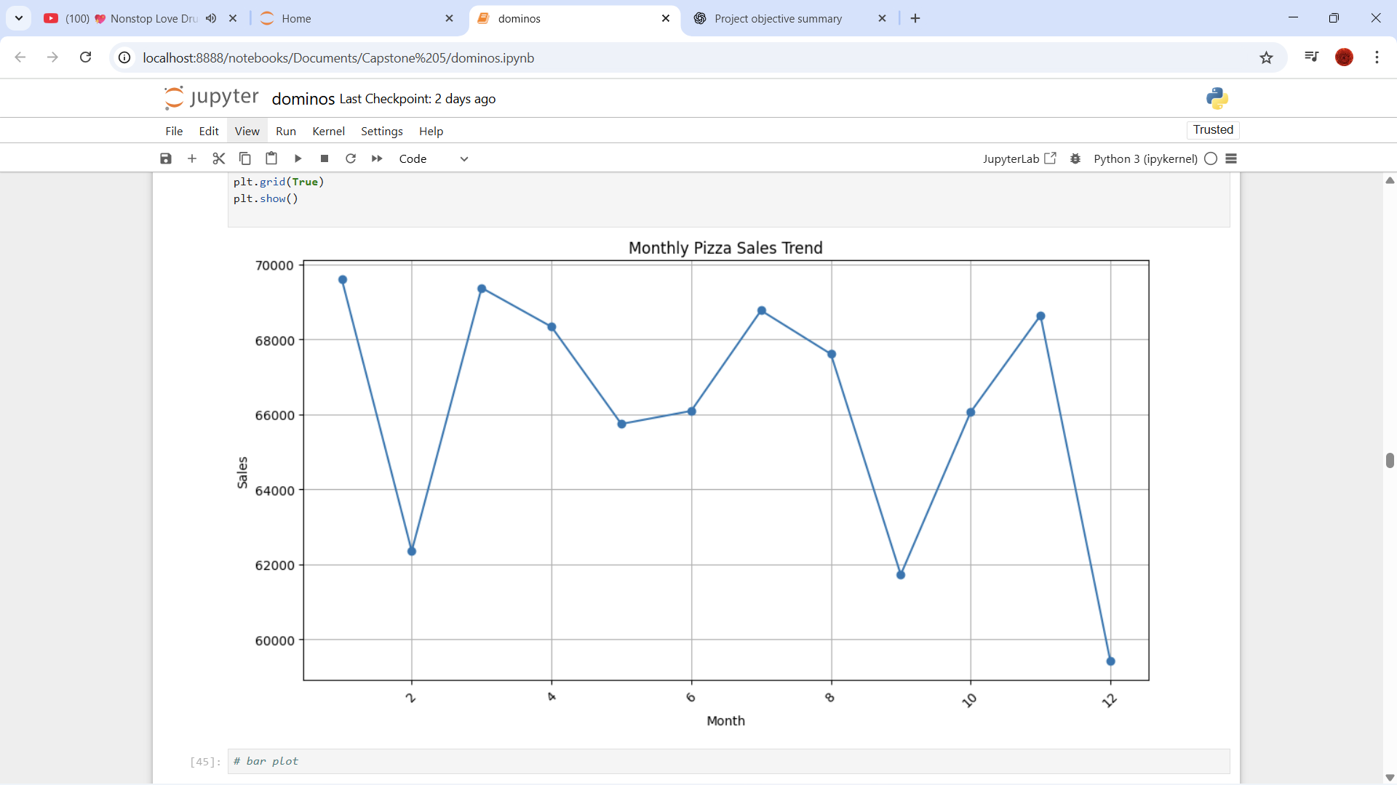
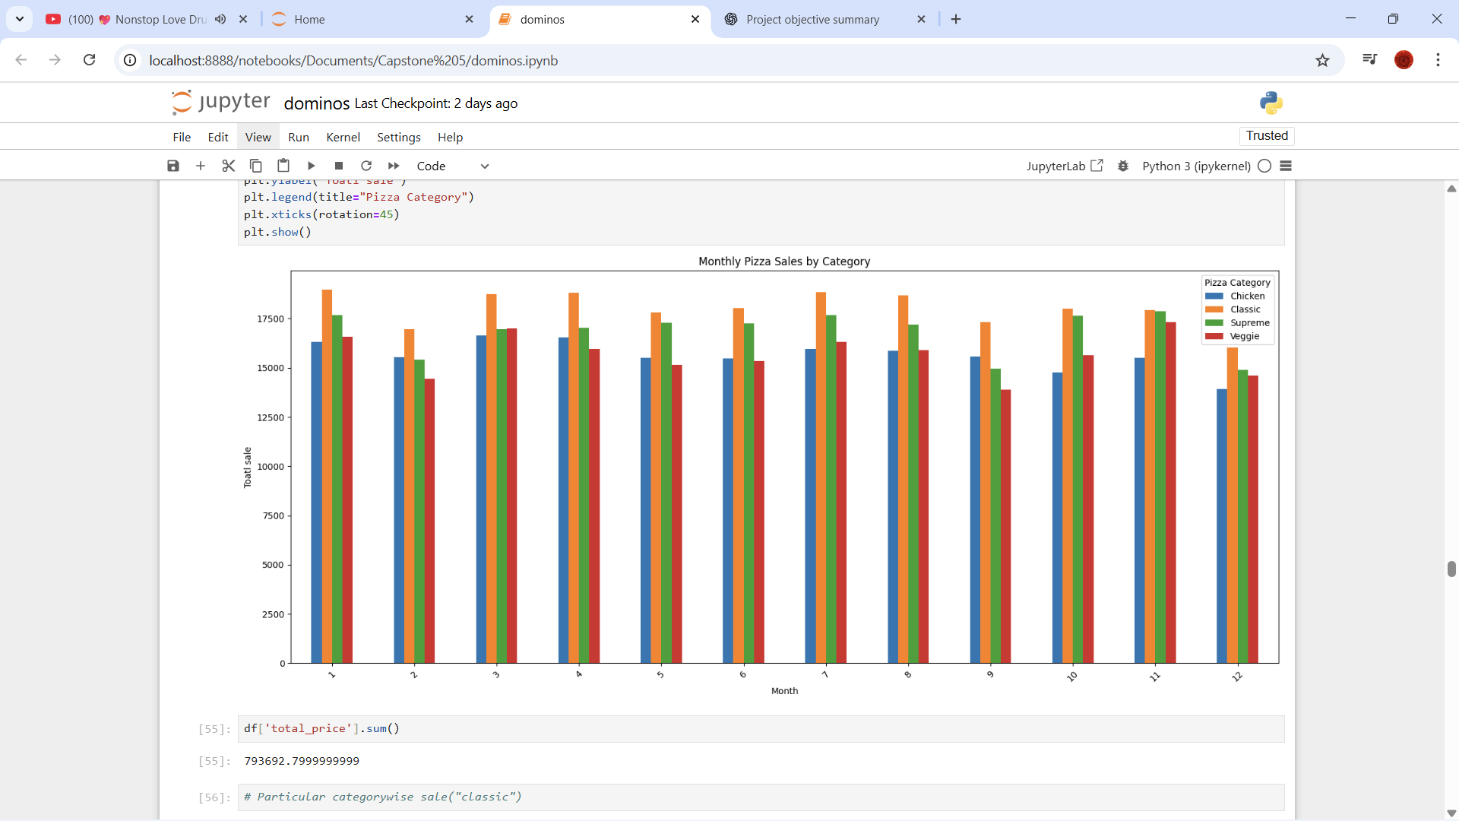
Monthly pizza sales
Monthly pizza sales by category

Slide 7
Total Sales - ₹7.94 Lakhs
Category-wise Pizza Sales
Size-wise Pizza sales

Slide 8
Top 3 Pizzas Under Each Category
Category | 1 | 2 | 3
Classic | The classic deluxe pizza | The hawaiian pizza | The pepperoni pizza
Supreme | The spicy italian pizza | The italian supreme pizza | The sicilian pizza
Veggie | The four cheese pizza | The mexicana pizza | The vegetables + vegetables pizza
Chicken | The thai chicken pizza | The barbecue chicken pizza | The california chicken pizza

Slide 9
Sales Prediction

Slide 10
Model Selection
Model Name | MAPE accuracy
ARIMA | 0.82%
PROPHET | 1.29%
SARIMA | 51.17%
LSTM | 50.4%

Slide 11
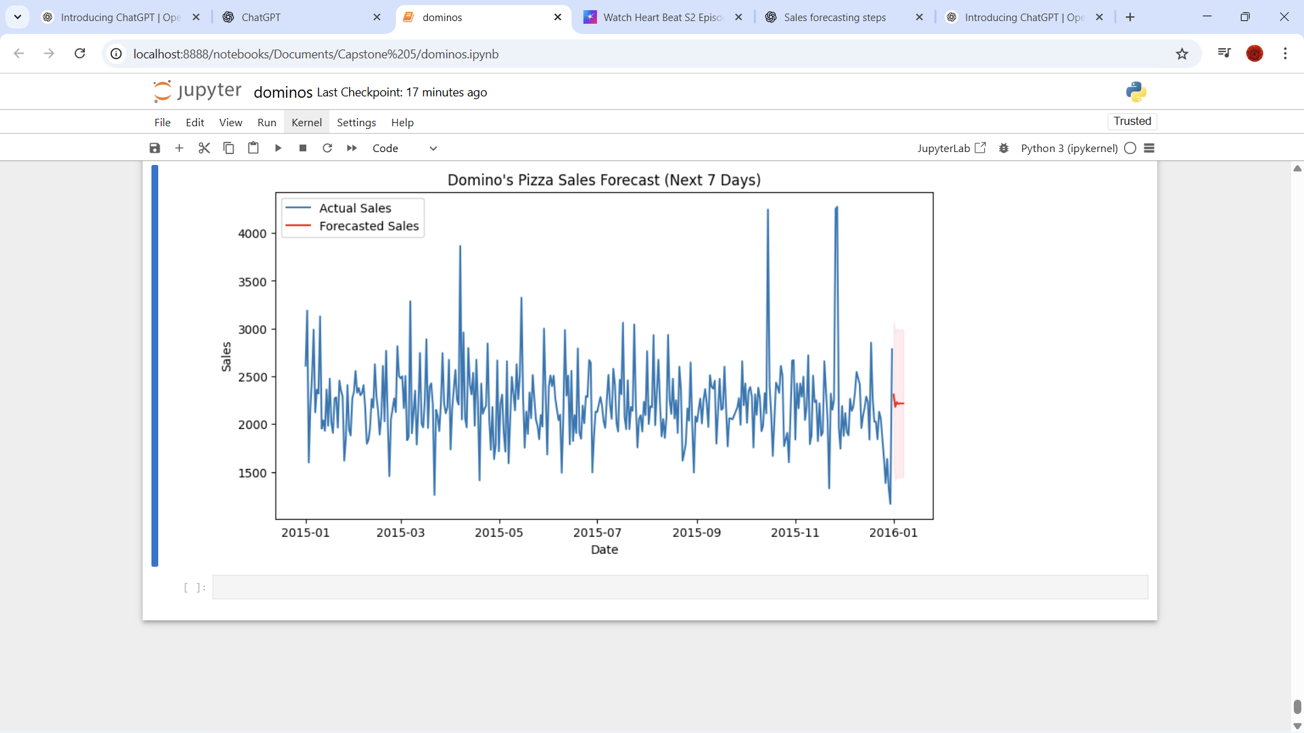
ARIMA
In our pizza sales forecasting, ARIMA gave the best performance with the lowest MAPE. This is because the sales data shows more of a trend and random fluctuations rather than strong seasonal or calendar-based patterns. ARIMA’s simplicity and ability to model such series directly made it superior to SARIMA (which overestimated seasonality), Prophet (which assumed holiday-like effects), and LSTM (which requires much more data and tuning). Hence, ARIMA is the most suitable model for this dataset.
Sales for next 7 days

Slide 12
Key Insights:
Forecasted sales are expected to remain close to average demand levels.
No major spikes or drops are anticipated, suggesting stable demand in the next week.
This forecast helps in inventory planning and purchase order creation (e.g., ensuring enough ingredients are stocked without over-ordering).

Slide 13
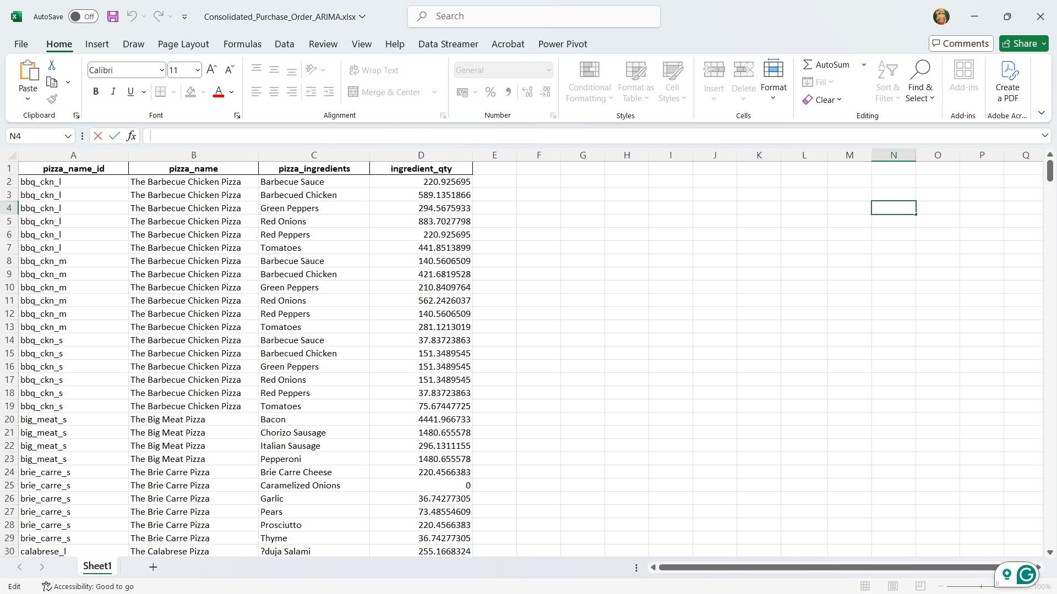
Ingredient Purchase Order:
This purchase order is generated using ARIMA-based sales forecasting for the next 7 days
For week: Purchase order for Next 7 days

